Slide 1

GROCERY ONLINE STORE
Submitted By: Under the guidance of
1.Ayesha Fatima
2.B.Pavani Pooja Mehta
3. B.Samyuktha
4. G.Ashwini
5. Pallavi Suresh Narwade

Slide 2
INTRODUCTION
The Online Shopping is a web based application intended for online retailers.
The main objective of this application is to make it interactive and its ease to use.
The search engine provide an easy and convenient way to search for products for users .
A user can search for a product interactively and search engine would refine the products available based on the user’s input.

Slide 3
PROJECT OBJECTIVE
The main objective of most grocery store companies is to sell products and earn the highest profits possible.
Online grocery shopping ordering potentially reduces the inconvience of grocery selection by eliminating trips to physical stores.
It physically enable consumers to shop much more quickly by occasion or for trips, precisely when a trip to the grocery store is most difficult.

Slide 4
TECHNOLOGIES USED
Java 1.8
Spring Framework 2.7.0+
Maven 4.0
Spring Web 0.0.1+
Spring Data JPA(Hibernate)
MySQL
Validation
Postman

Slide 5
REQUIRED SPECIFICATION
Hardware Configuration | Software Configuration
System:64-bit Operating System | Software IDE: Spring tool suite
RAM: 4GB Hard Disk: 1TB | Language: Java
Operating System: Windows 10 | Back End: MySQL Server,Postman

Slide 6
PROPOSED SYSTEM
The Proposed system ensures the complete freedom for users. where user at his own system can log on to this website and can book his product. Our proposed system allows only registered users to book the product, view booking and cancel their booking as per their needs.
In this proposal the entire work is done on online. Particularly if the manages the small grocery store inventory requires more than simply keeping enough of every item in stock.

Slide 7
ADVANTAGES
Clients can order whenever they want.
Easy sign-up process.
Enhanced search.
Makes the ordering process easier.
Customer’s Satisfaction.
The convience of mobile ordering.
No more waiting in long queues to place an order
Discover New Items
Add shopping list items
Add to cart option

Slide 8
SPRING ANNOTATIONS
@Entity: The @Entity specifies that the class is an entity and is mapped to a database table.
@Table: The @Table specifies the name of the database table to be used for mapping.
@Id: The @Id specifies the primary key of the entity.
@Column: The @Column is used for adding the column the name in the table of a particular MySQL database.
@JoinColumn: The @JoinColumn helps us specify the column we will use for joining an entity association.
@OneToManyMapping: The @OneToManyMapping is used to create the one-to-many relationship between the Student and phone entities
@ManyToOneMapping: The @ManyToOneMapping is used to create the many-to-one relationship between the student and Address entities.

Slide 9
@Repository: The @Repository is used to indicate the class provides the mechanism for storage, retrieval, update, delete and search operation on objects.
@RestController: The @RestController is used at the class level and allows the class to handle the requests made by the client.
@GetMapping: The @GetMapping uses for the read operation.
@PostMapping: The @postMapping should only be used to create a new resource.
@PutMapping: The @PutMapping update an existing resource. .

Slide 10
@DeleteMapping: The @DeleteMapping to remove a given resource.
@RequestMapping: The @RequestMapping is used to map onto specific handler classes and handler methods.
@RequestBody: The @RequestBody allows us to retrieve the request’s body.
@PathVariable: The @PathVariable is used to extract the value from the URI.
@Autowired: The @Autowired is used to auto-wire a bean into another bean.
@Service: The @Service is used at the class level. It tells the spring that class contains the bussiness logic.

Slide 11
USE CASE DIAGRAM
Use case diagram consists of Admin and Users and shows the interaction between them.
The main purpose is to show the interaction between the Admin and the Users.
The Admin are the functions that are to be performed in the module.
A user could be the end-user of the system or external system.

Slide 12
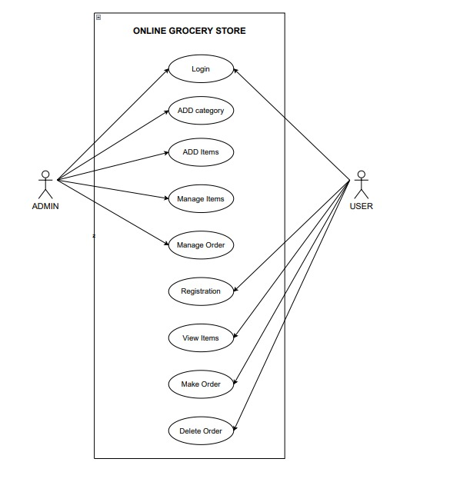

Slide 13
CLASS DIAGRAM
A class diagram is a UML diagram type that describes a system by visualizing the different types of objects with in a system and the kinds of static relationships that exist among them.
It also illustrates the operations and attributes of the classes.

Slide 14
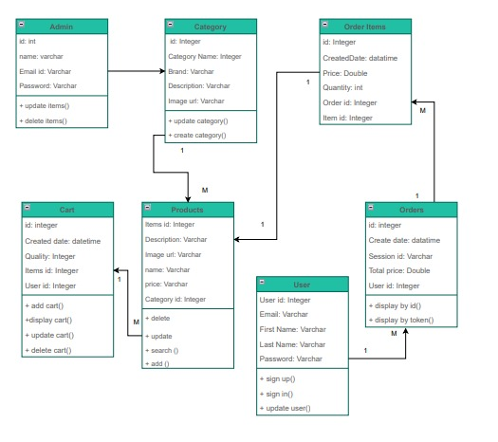

Slide 15
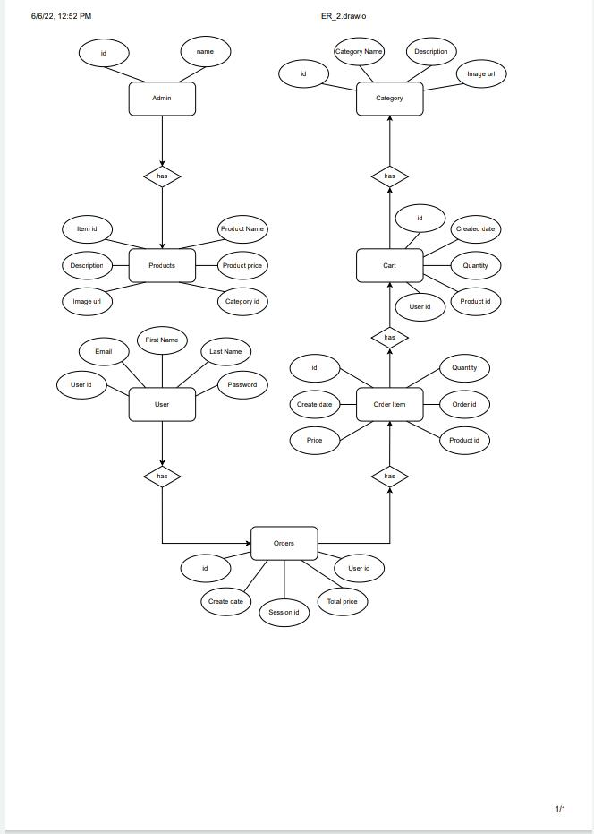
ER DIAGRAM

Slide 16
SPRING BOOT PROJECT ARCHITECTURE
GET
POST
PUT
DELETE
API Layer
Bussiness Logic
Persistence Logic
Postman
Client
Controller
Service
DAO
DB

Slide 17
Resource
Admin
Category
Product
Order
Cart
User
POST
Create
Create a new Admin
Create a new Category
Create a new Product
Create a new Order
Create a new Cart
Create a new User
GET
Read
Get All Admin details
Get All Category details
Get All Product details
Get All Order details
Get All Cart details
Get All User details
PUT
Update
Update Admin details
Update Category details
Update Product details
Update Order details
Update Cart details
Update User details
DELETE
Delete
Delete Admin Details
Delete Category Details
Delete Product Details
Delete Order Details
Delete Cart Details
Delete User Details

Slide 18

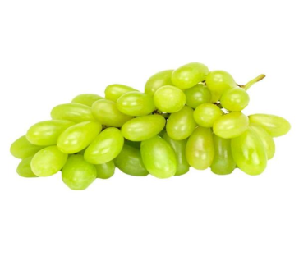


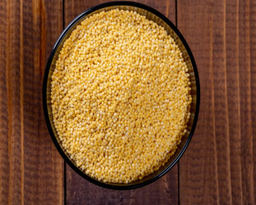
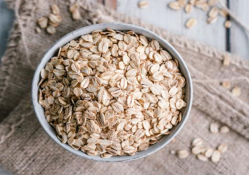
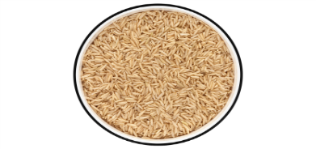
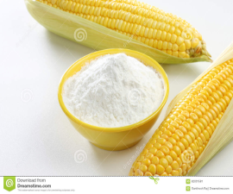
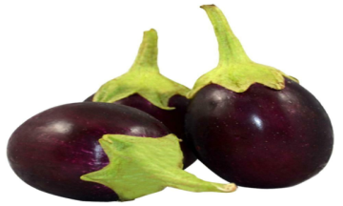
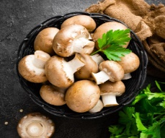
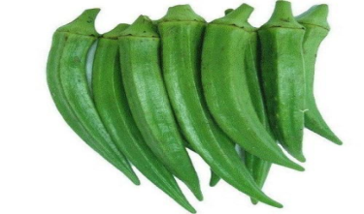

PRODUCTS PAGE
FRUITS
Apple
Grapes
Pine Apple
Mango
GRAINS
Millets
Oats
Brown Rice
Corn Flour
VEGETABLES
Mushroom
Lady’s Finger
Brinjal
BitterGuard

Slide 19
ABOUT BACKEND
A. Service:
Spring boot service component is defined as a class file that includes the @Service annotation and allows developers to add bussiness functionalities. The annotation used with the classes that provide these bussiness functionalities.
B. Repository:
Spring is a popular Java application framework and Spring Boot is an evolution of Spring that helps create standalone, production grade Spring based applications easily.@Repository is a Spring annotation that indicates that the decorated class is a repository.

Slide 20
C. POJO Classes:
The POJO class is an object that the encapsulates the Bussiness logic. In an MVC architecture, the controller interacts with the bussiness logic, which contacts with POJO class to access the data. It is the working of the POJO class. How to use POJO class in a java program. The POJO class is created to use the objects in other java programs.
D. Controller Classes:
In Spring Boot, the controller class is responsible for processing incoming REST API requests, preparing a model, and classes in Spring are annotated either by the @Controller or the @Rest Controller annotation.

Slide 21
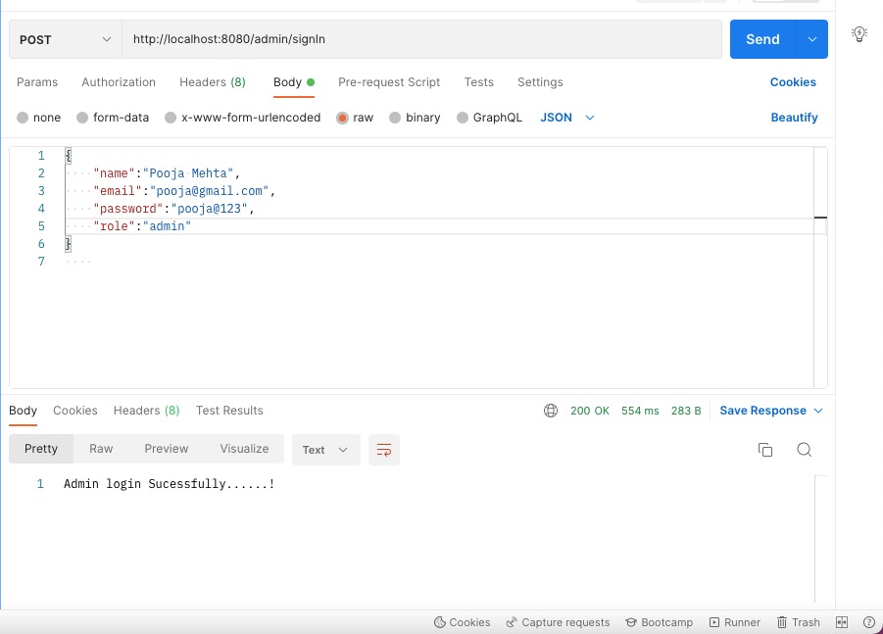
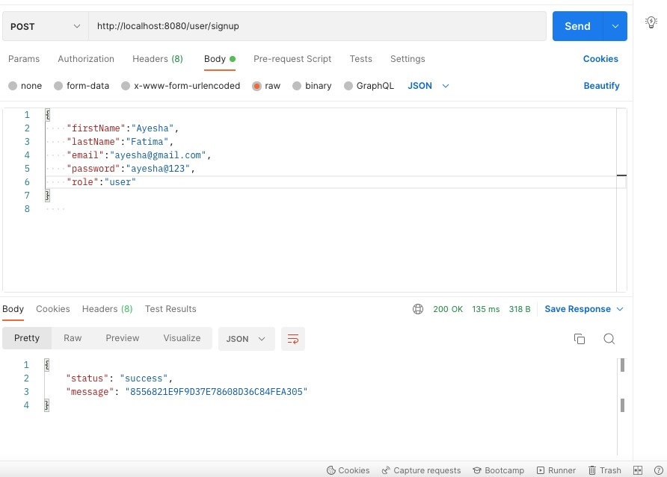
OUTPUT SCREENSHOTS
Admin
User SignUp

Slide 22
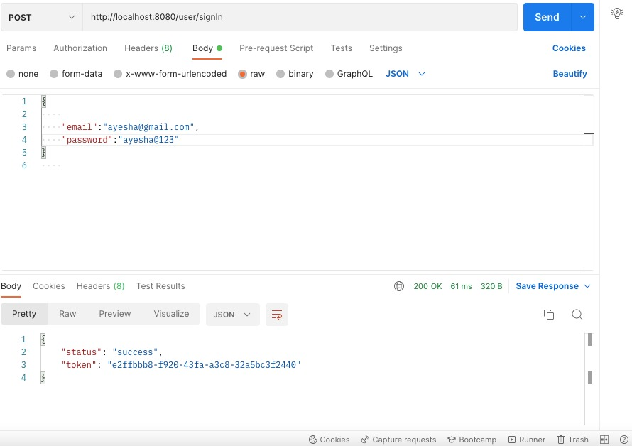
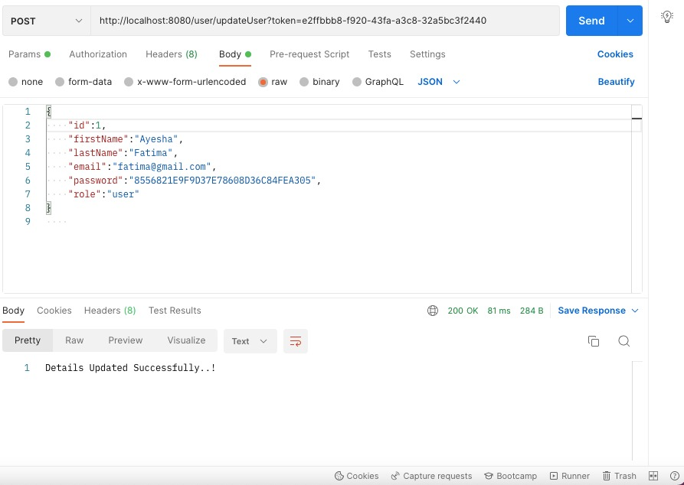
User SignIn
Update User

Slide 23
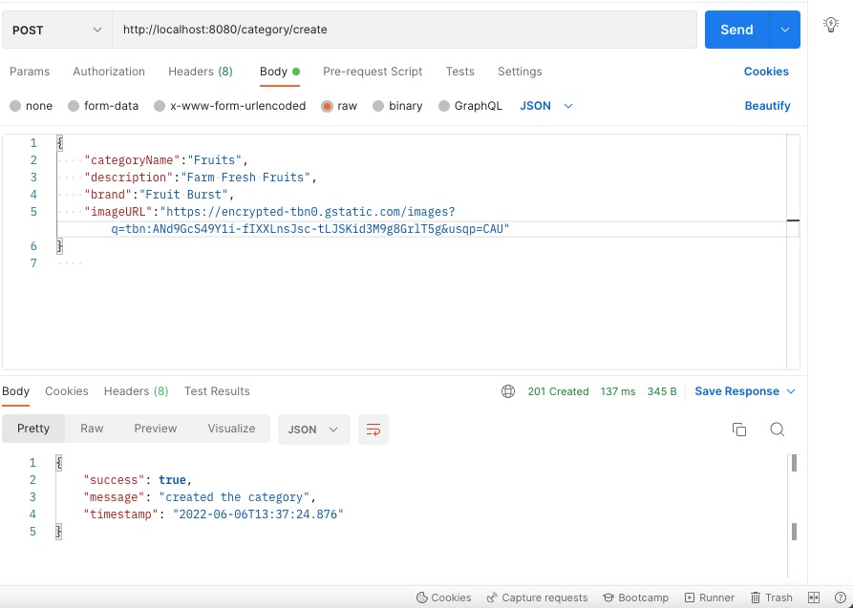
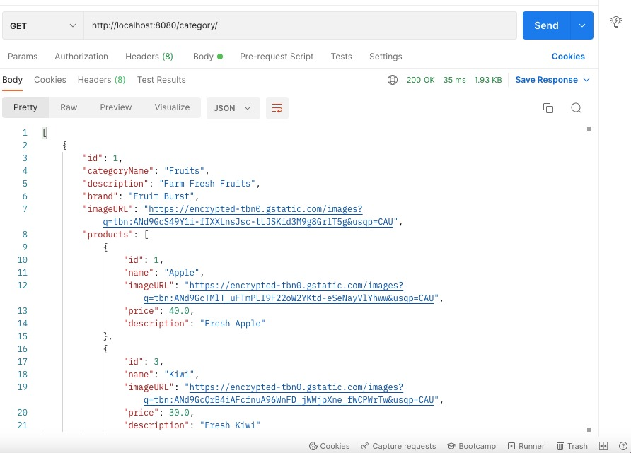
Category
CategoryGet

Slide 24
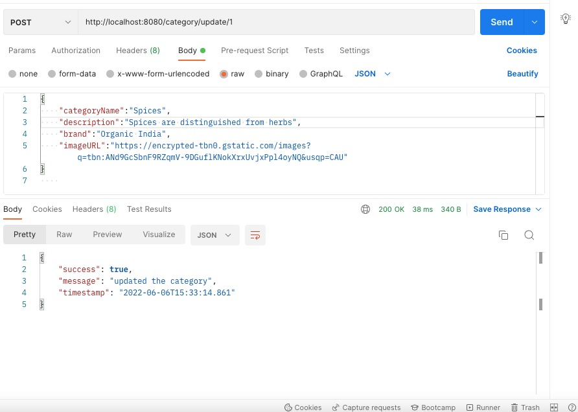
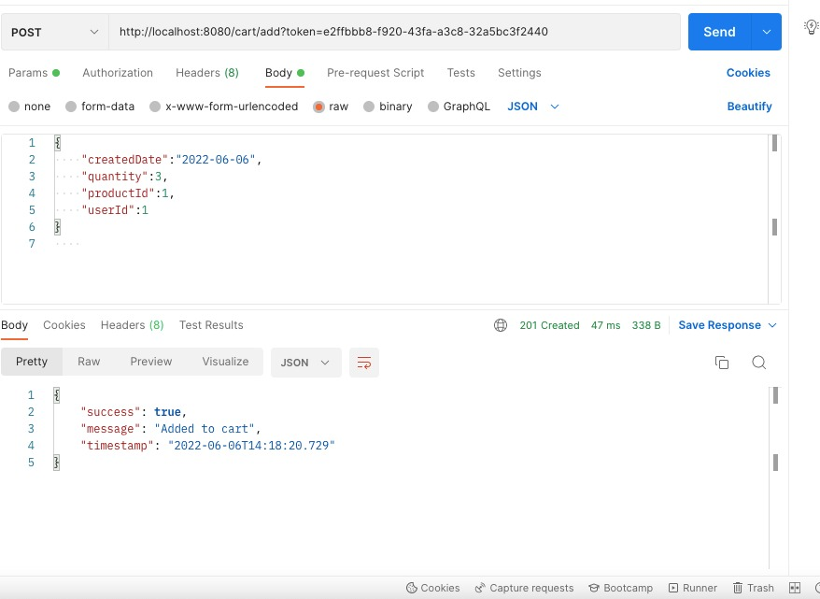
CategoryUpdate
Cart

Slide 25
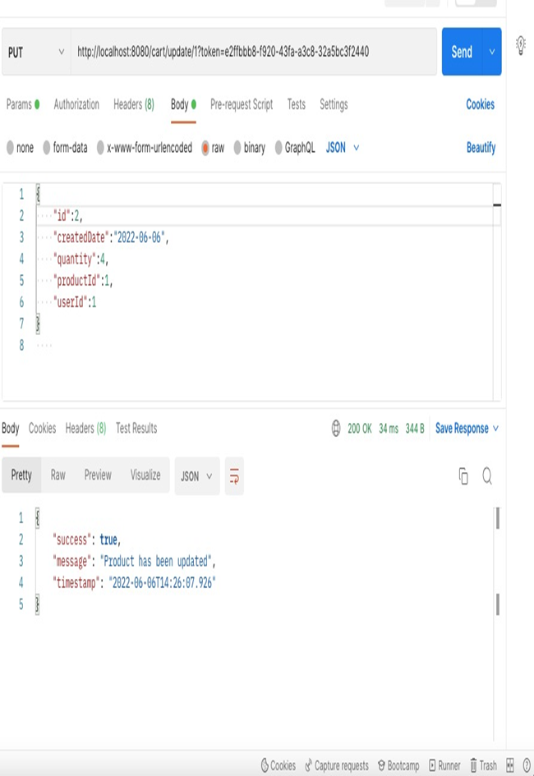
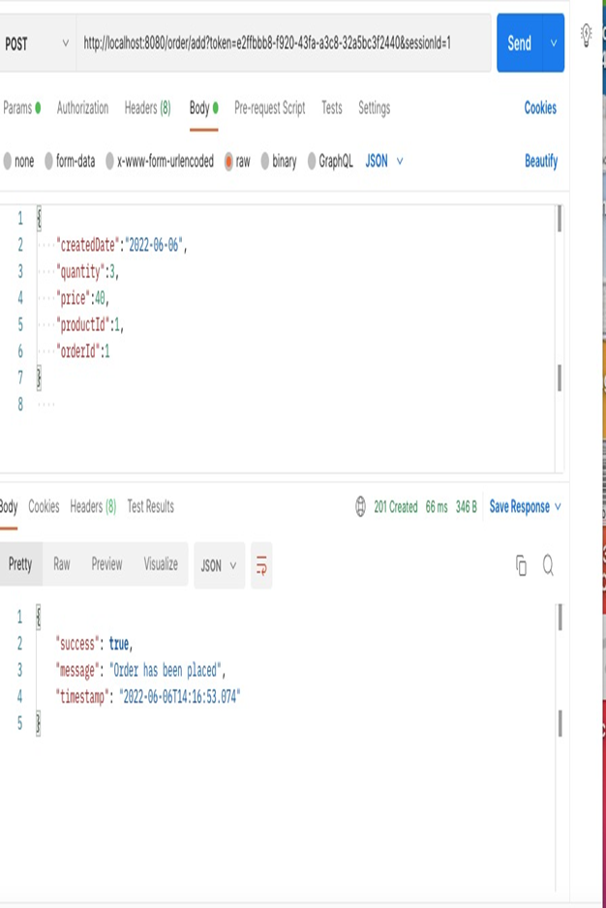
CartUpdate
Order

Slide 26
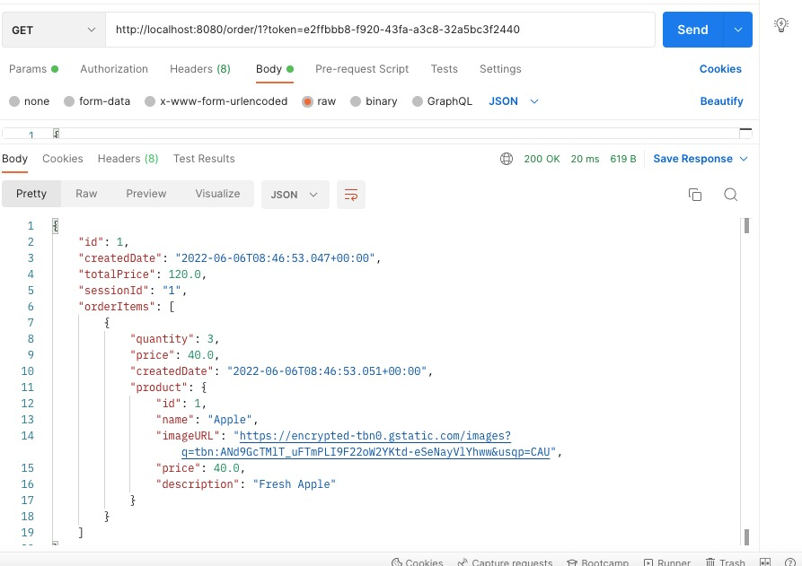
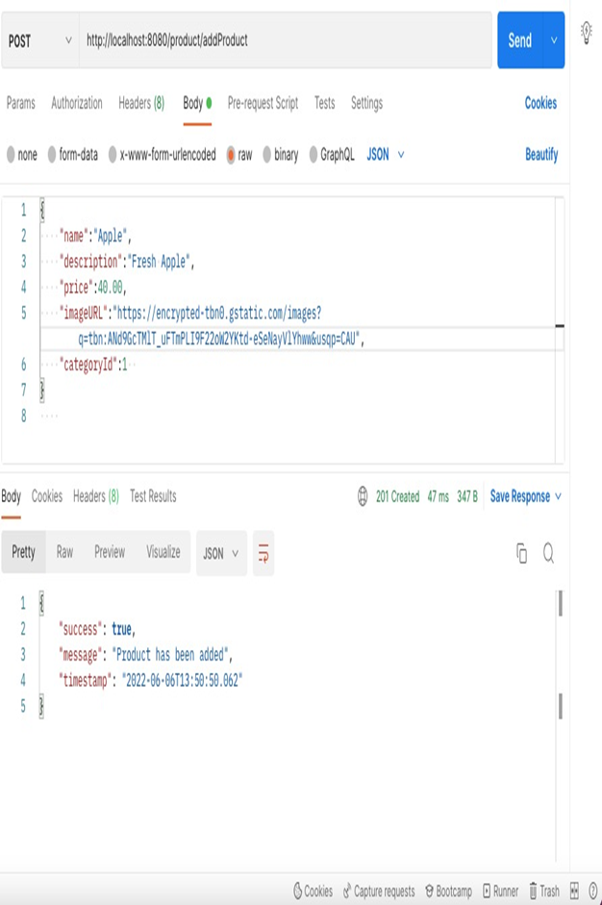
OrderGet
Product

Slide 27
CONCLUSION
Technology has made significant progress over the years to provide consumers a better online shopping experience and will continue to do so for years to come.
With the rapid growth of products and brands, people have speculated that online shopping will overtake in-store shopping.
At the end, it has been a win-win situation for both consumers and sellers.

Slide 28


